Slide 1
Deep Learning Based Fish Species Classification
Tiffany Li, Sainath Veerla, Jinthy Swetha Mamillapalli, Deva Kumar Gajulamandyam
Department of Applied Data Science, San José State University
DATA 270 Data Analytics Processes
Dr. Eduardo Chan
November 20, 2023

Slide 2
Agenda
Project Background
Project Workflow
Project Requirements
Technology Survey
Project Resources
Project Plan
Data Source
Data Exploration
Data Processing
Machine Learning Models
Results
References

Slide 3
Project Background
Motivation
Needs and Importance
Compared to traditional manual classification, deep learning offers enhanced efficiency, scalability, and precision in fish species classification
Enhancing understanding of marine ecosystem and biodiversity.
Implementing targeted strategies in marine conservation
Filling previous research gaps.
Integrating datasets for comprehensive insights.
Achieving efficiency and high precision with deep learning.
Targeted Problem
Deliverables
Automating the fish classification task to address minor morphological differences and enhance accuracy
Develop and implement a high-precision deep learning model for the classification of diverse species.

Slide 4
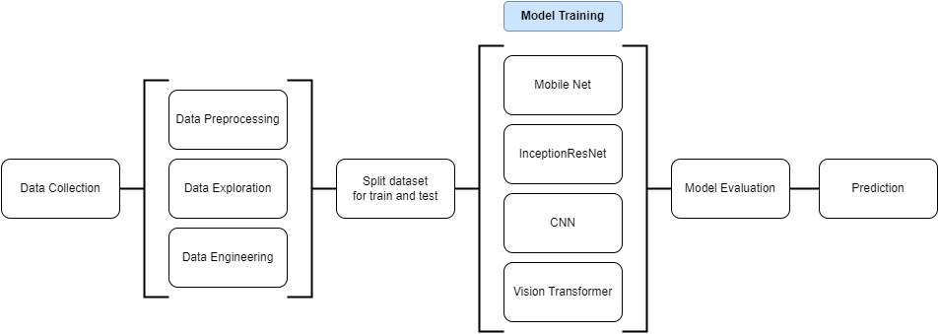
Project Workflow

Slide 5
Project Requirements
Functional Requirements
AI Requirements
Data Requirements
The system should be able to
Classify input images into corresponding fish species.
Leveraging Google Cloud Platform for storage and modelling
Customizing pre-trained architectures from the Keras Python library for model development.
Employ quantitative metrics (accuracy, F1 score, and learning loss) to evaluate model performance.
Automate MLOps Capabilities Streamlined retraining as new images are collected
Utilize AI models capable of handling extensive datasets and autonomously identifying relationships within the data.
Favor models that are robust and efficient, with a focus on supervised learning.
Accurate species classification and detection using tailored convolutional neural networks.
MobileNet enables optimizations for edge devices and Vision Transformers to enhance inter-pixel relationships.
Explore Inception-ResNet architectures for improved performance.
The dataset should
Include a wide range of fish species from different habitats and regions.
Ensure image quality, consistency and completeness.
Be accurately labeled.
Sufficiently large to effectively train machine learning models.

Slide 6
Technology Survey
Comparison of existing solutions
Author | Dataset | # of species | Architecture | Result
Salman et al. (2016) | LifeCLEF-14, LifeCLEF-15 | 10, 15 | CNN-SVM, CNN-KNN | 96.75% (LCF-14), 93.65% (LCF-15)
Rathi et al. (2017) | Fish4Knowledge | 21 | CNN | Accuracy of 96%
Tharwat et al. (2018) | Undisclosed data source | 4 | Weber’s Local Descriptor + LDA + AdaBoost | Accuracy of 96%
M.A. Iqbal et al. (2021) | QUT (training) LifeCLEF-15 (testing) | 6 | Reduced AlexNet | Accuracy of 90%
Villon et al. (2021) | T0, T1, T2 (from 175 underwater videos) | 20 | Few-Shot Learning | Mean accuracy of (64.92 ± 14.55)% for k=30 shots on T0
Prasetyo et al. (2022) | Fish-gres, Fish4Knowledge | 8, 23 | MLR + VGGNet (VGG16 & VGG19) | Accuracy of 98.5% (Fish-gres) Accuracy of 97% (F4K)

Slide 7
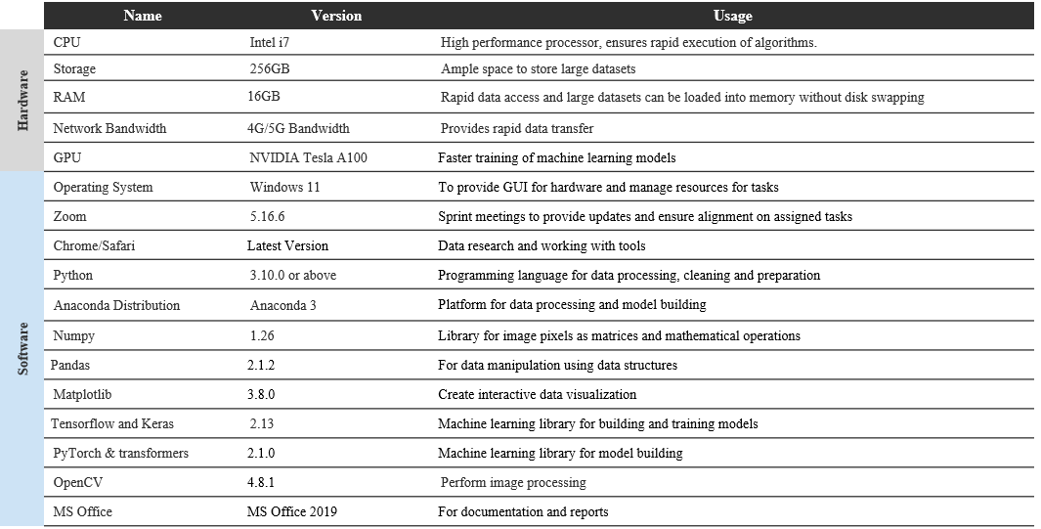
Project Resource Requirements

Slide 8
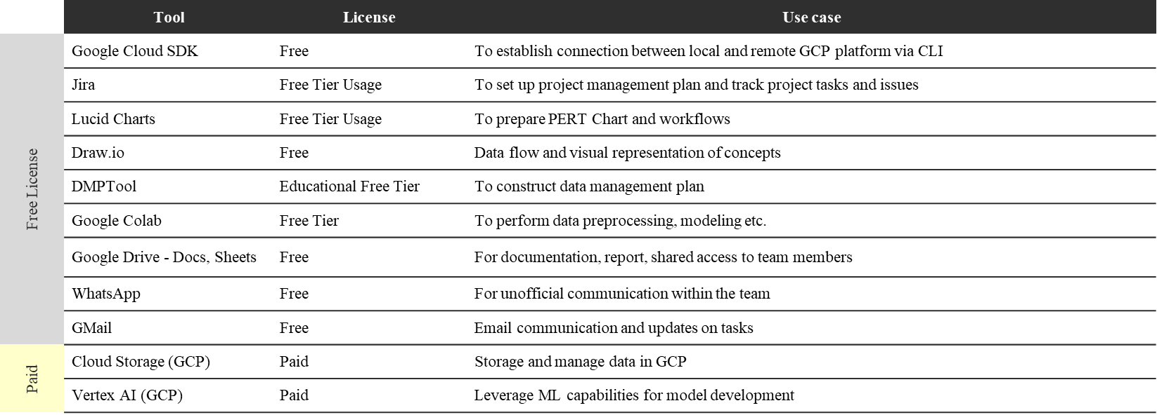
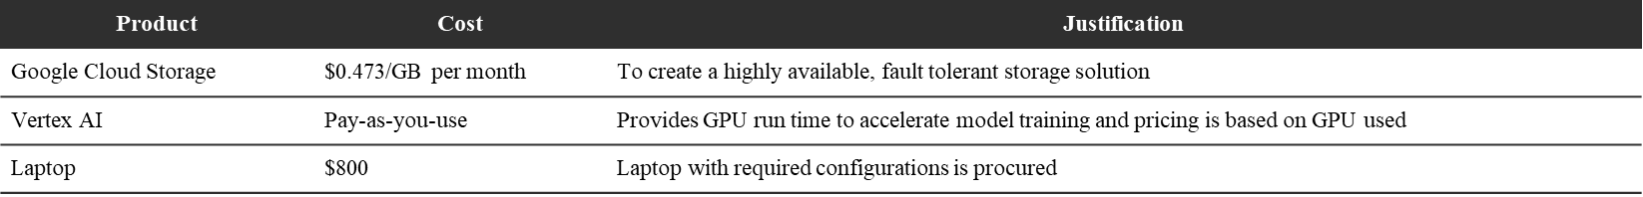
Project Resource Requirements
Tools and license used

Slide 9
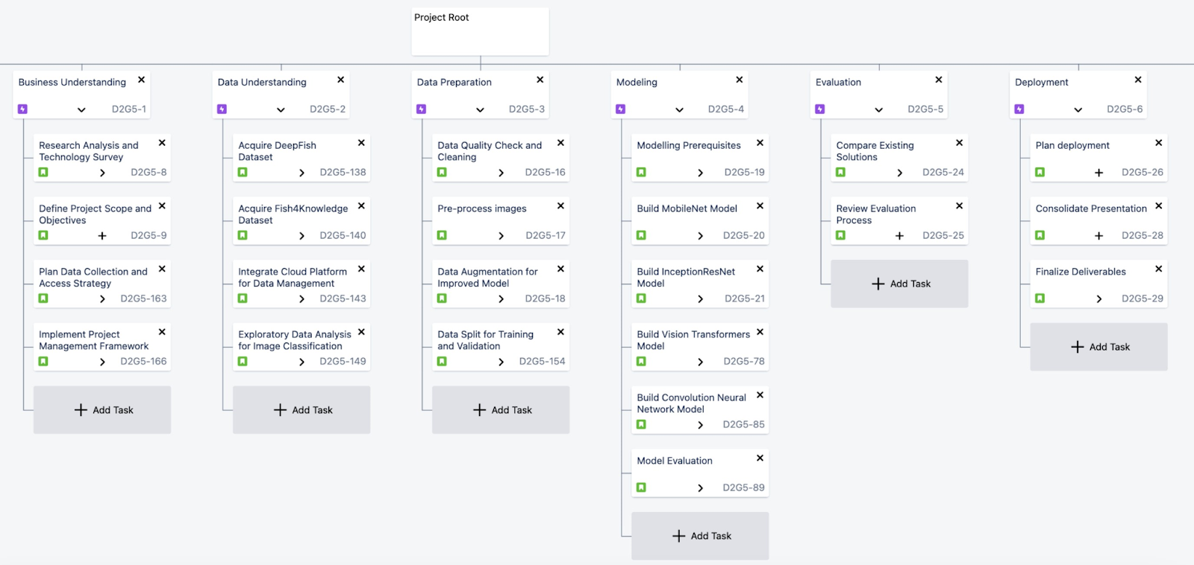
Project Plan – WBS

Slide 10
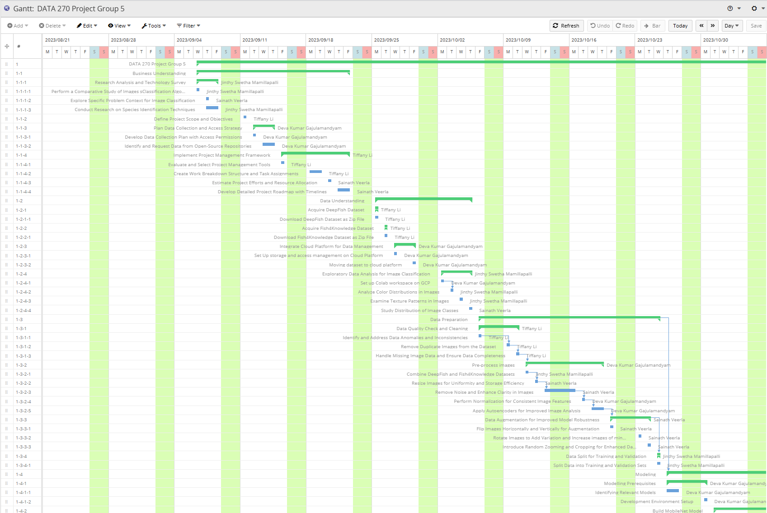
Project Plan – Gantt Chart

Slide 11
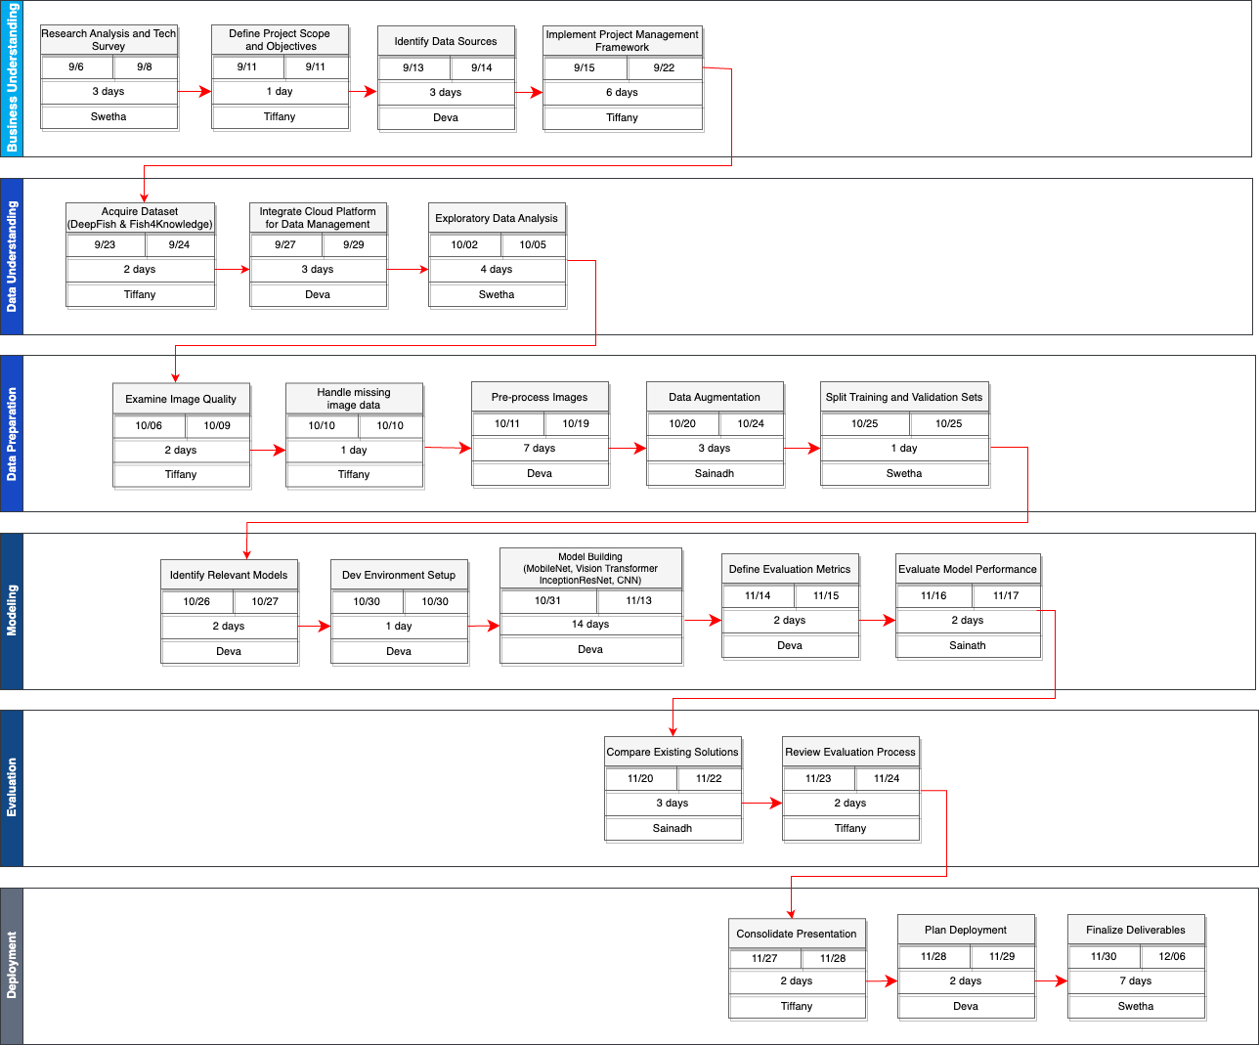
Project Plan – PERT Chart

Slide 12
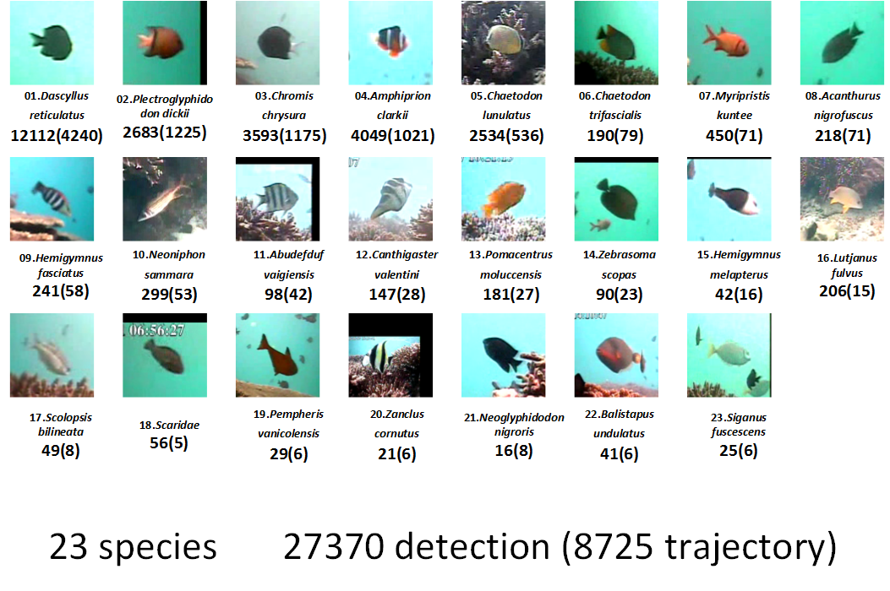
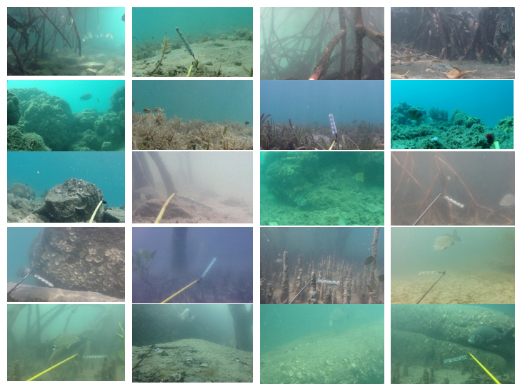
Data Source
Source: Fish4Knowledge
Authors: University of Edinburgh, Taiwan Ocean Research Institute and Kenting National Park
Link: https://homepages.inf.ed.ac.uk/rbf/Fish4Knowledge/
Data collection period: 10/1/2010-9/30/2013
Data collection instruments: Camera, Acoustic depth sounder
Geographic coverage: Southeast of Taiwan’s coral reef areas
Data format: Image data
Data size: 450 MB
Images: 27,370
Source: DeepFish
Authors: Saleh, A., Laradji, I.H., Konovalov, D.A. et al. at James Cook University
Link: https://alzayats.github.io/DeepFish/
Data collection period: 2012-2013
Data collection instruments: Camera, Acoustic depth sounder, GPS
Geographic coverage: Australia
Data format: Image data
Data size: 5.5 GB
Images: ~40,000

Slide 13
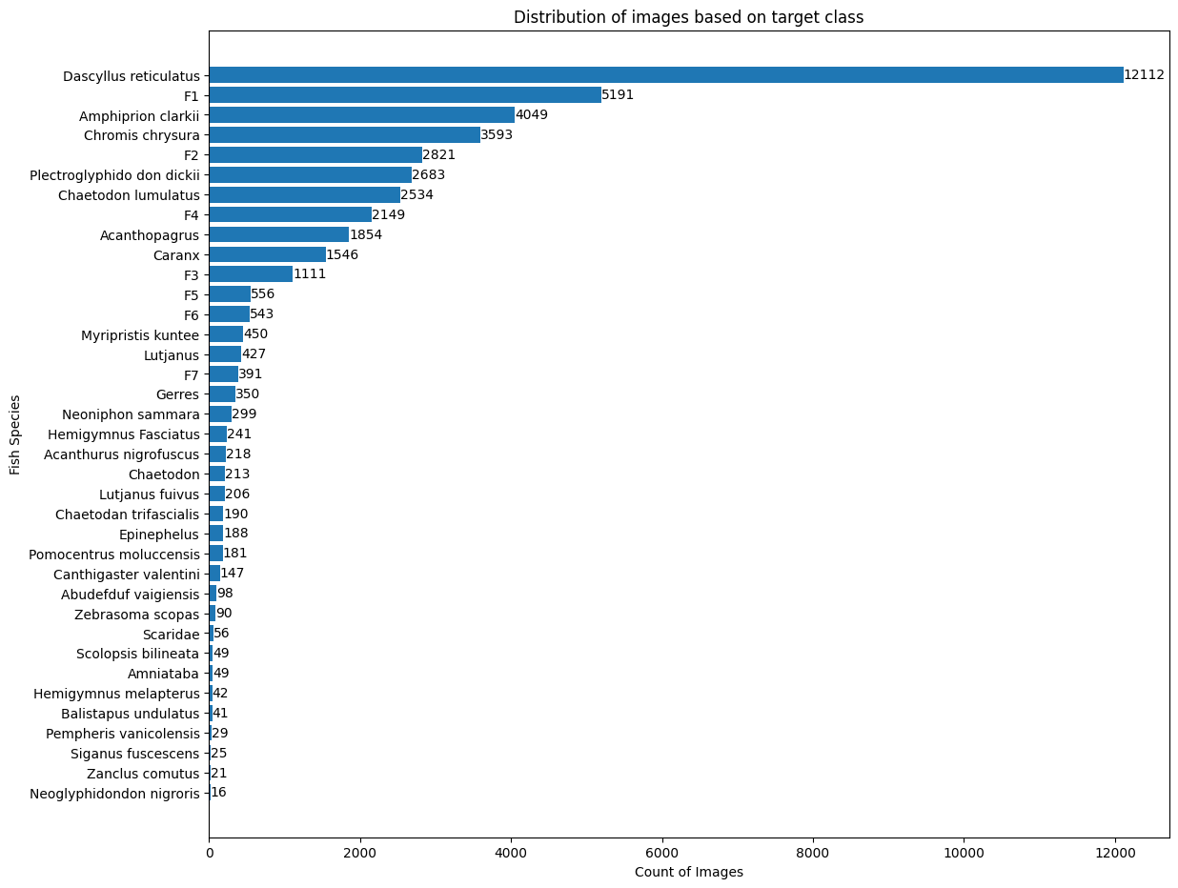
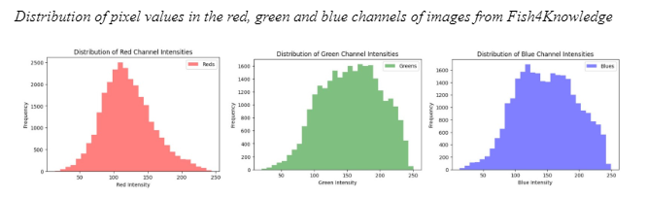
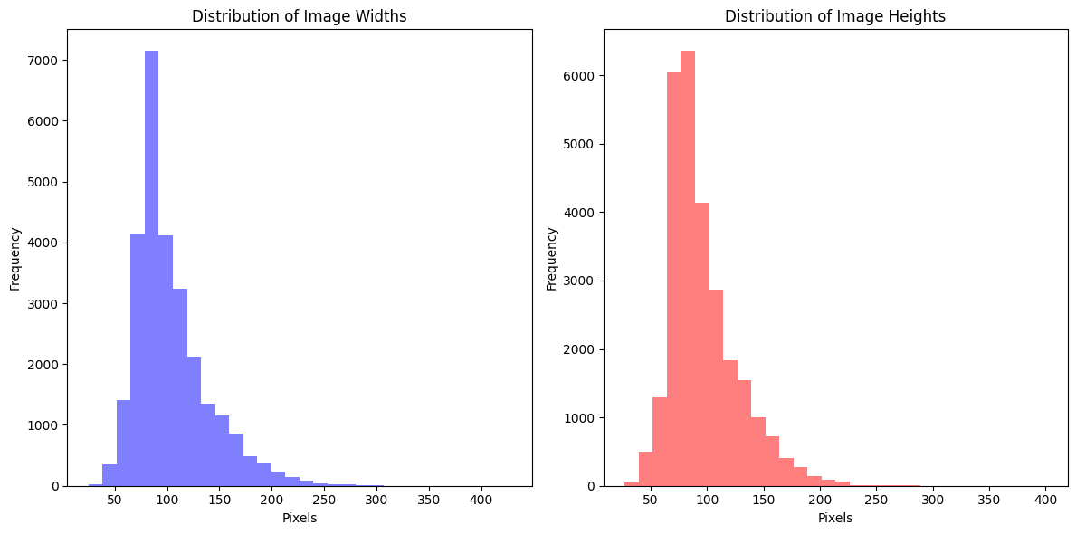
Data Exploration

Slide 14
Data Processing
Data Collection
Data
Pre-processing
Data
Transformation
Data Preparation
Merging
Fish4Knowledge
DeepFish
Missing Data
Sampling &
Augmentation
Data Smoothing
Bilateral filtering
Training Set 70%
168 images
Noisy Data
Denoising
(Median Filtering)
Data Normalization
Rescaling pixels to 0-1
Validation Set 15%
36 images
Inconsistent Data
Reshaping all images to 256*256
Data Enhancement
Adjust brightness & contrast
Test Set 15%
37 images
Data Reduction
SVD

Slide 15
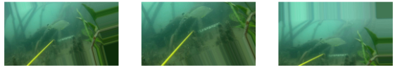
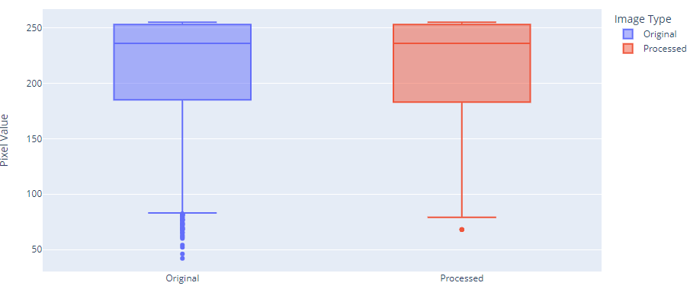
Data Preprocessing
Missing Data - Folders that are named empty are removed. Augmentation is used as a oversampling technique to create a balanced dataset.
Noisy Data - Noisy data is removed using median filter. It helps in mitigation of outliers and more refined distribution
Inconsistent Data - Images are of different sized, they
are converted to consistent size which would enhance
performance of machine learning model.

Slide 16
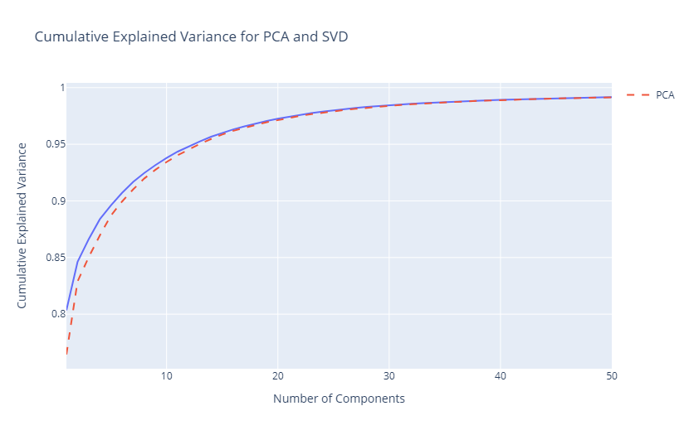
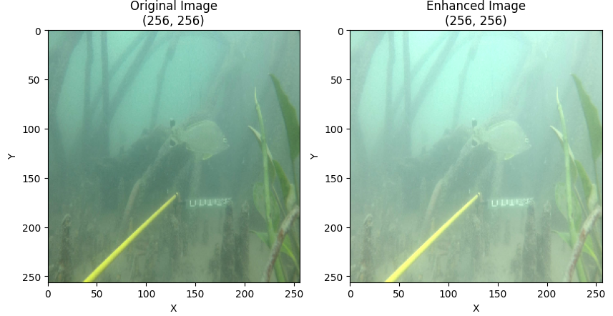
Data Transformation
Smoothing - detection of false edges by applying filters to the image.
Normalization - achieve uniformity without losing the information
Enhancement - Images are enhanced in terms of brightness and contrast to compensate for low lighting conditions in underwater
Reduction using SVD

Slide 17
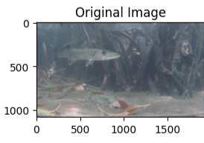
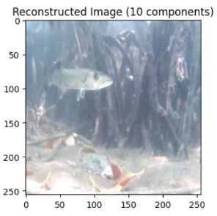
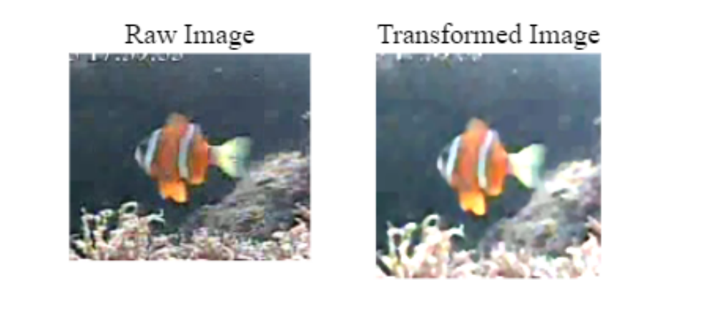
Original vs. Transformed Image

Slide 18
Machine Learning Models
 | Mobile Net | Inception ResNet | CNN | Vision Transformer
Description | Optimized for mobile and embedded vision applications; lightweight and trained on IMAGENET dataset | Uses inception modules with residual connections to allow for more efficient computation | Usage of convolutional layers to efficiently process grid-like topology and pooling layers with dropout & FC layers | Leverages self-attention mechanisms to process images as sequences
Advantages | Low Inference Time & lower parameters, Computationally Inexpensive | Pretrained models available, Robust to overfitting,Efficient transfer learning from pre-trained models | Customizable, Pre-trained models available | State-of-the-art performance on image classification tasks
Disadvantages | Large Architecture, Requires customization for domain specific tasks | Requires high Computational Resources, Complex architecture | Requires lot of trial and error, High chances of under-fitting | Requires large amounts of data and compute resources
Justification | Ideal for on-device applications due to low computational requirements, enabling real-time applications on mobile and IoT devices. | Handles multi-scale information well; versatile for various image sizes and complexities, useful for pattern recognition at different spatial scales. | Proven effectiveness for image classification; learns spatial hierarchies of features, suitable for facial recognition and object detection. | Achieves state-of-the-art results by treating images as sequences, beneficial for tasks requiring relational understanding between image parts.
Accuracy | 96 % | 93 % | 95% | 92%

Slide 19
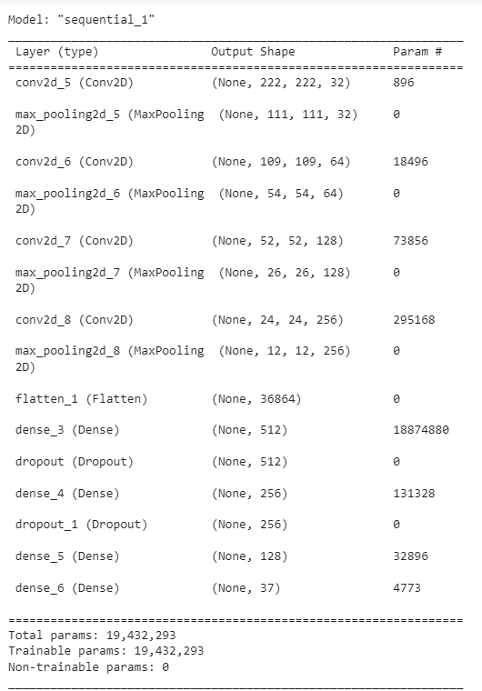
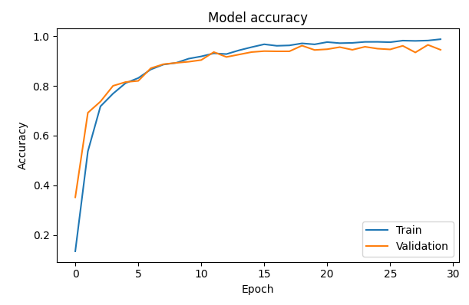
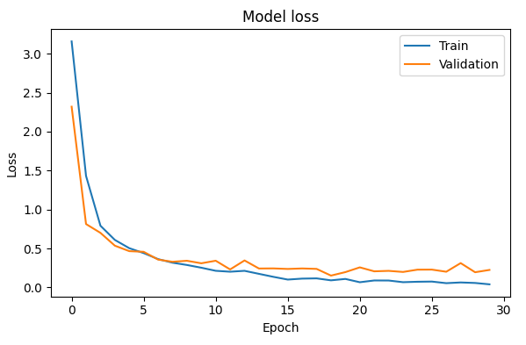
CNN
Epochs: 30
Optimizer: Adam
Learning Rate: 0.001
Training Time: 25 minutes (on P100 GPU)
Train Acc: 98.7%
Test Acc: 94.4%

Slide 20
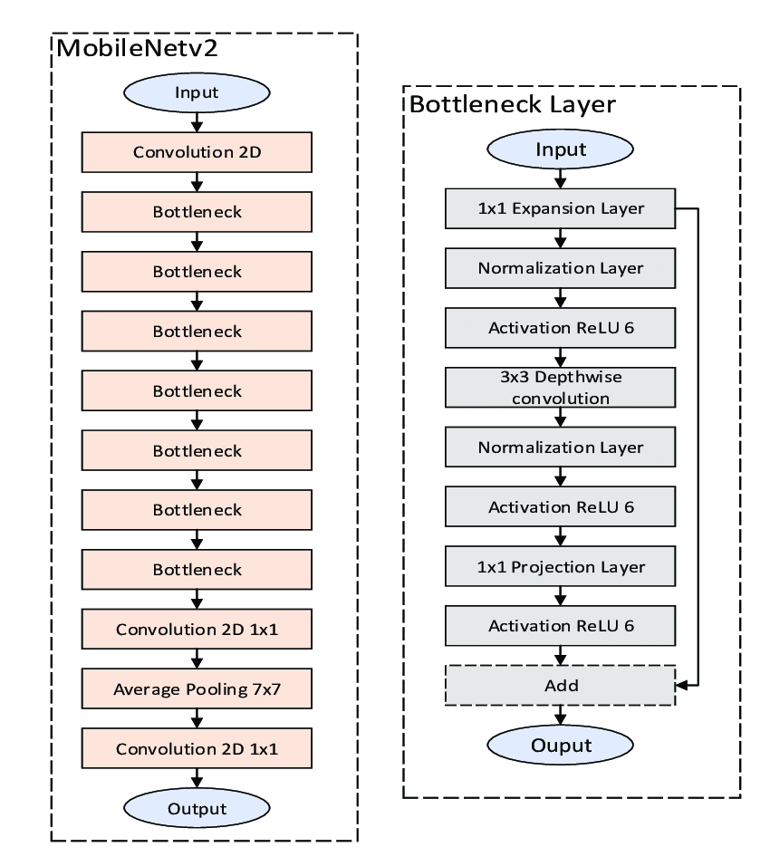
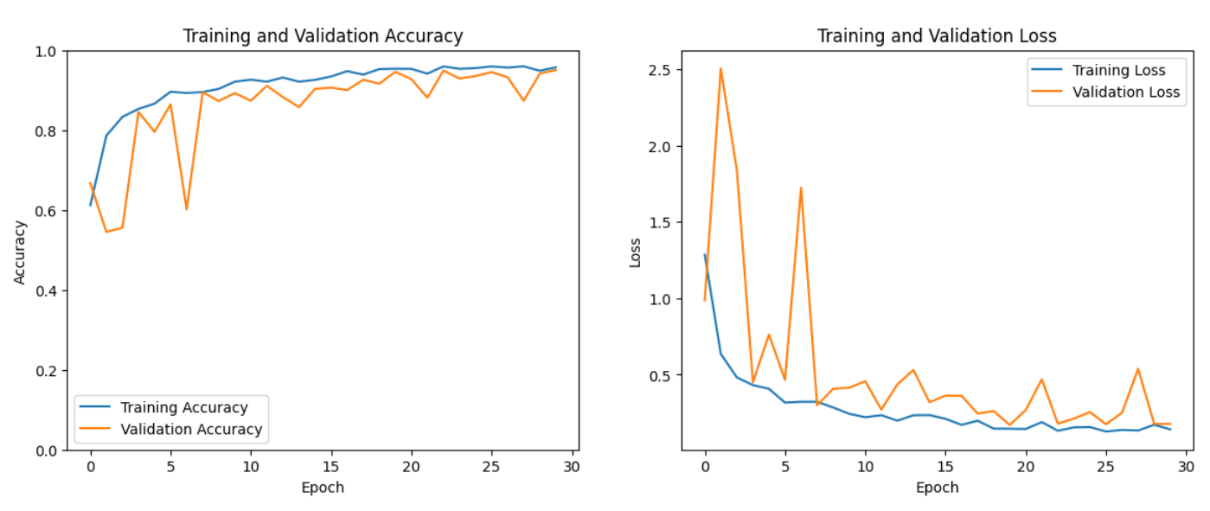
MobileNet
Epochs: 30
Optimizer: Adam
Learning Rate: 0.001
Training Time: 65 minutes (on T4 GPU)
Train Acc: 95.7%
Test Acc: 96.3%

Slide 21
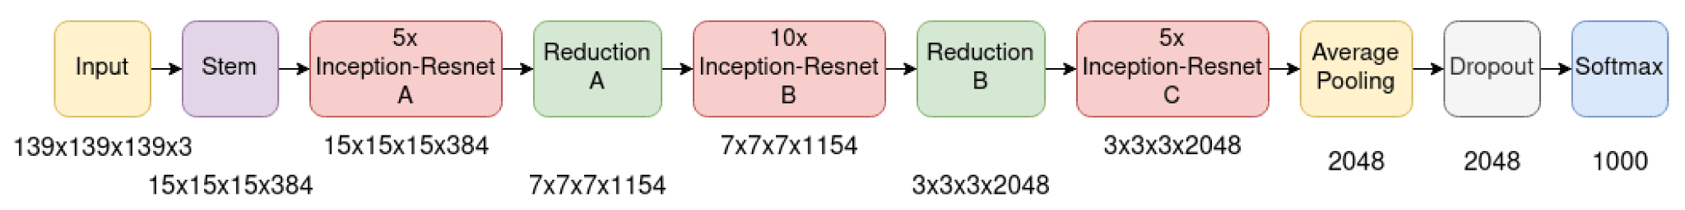
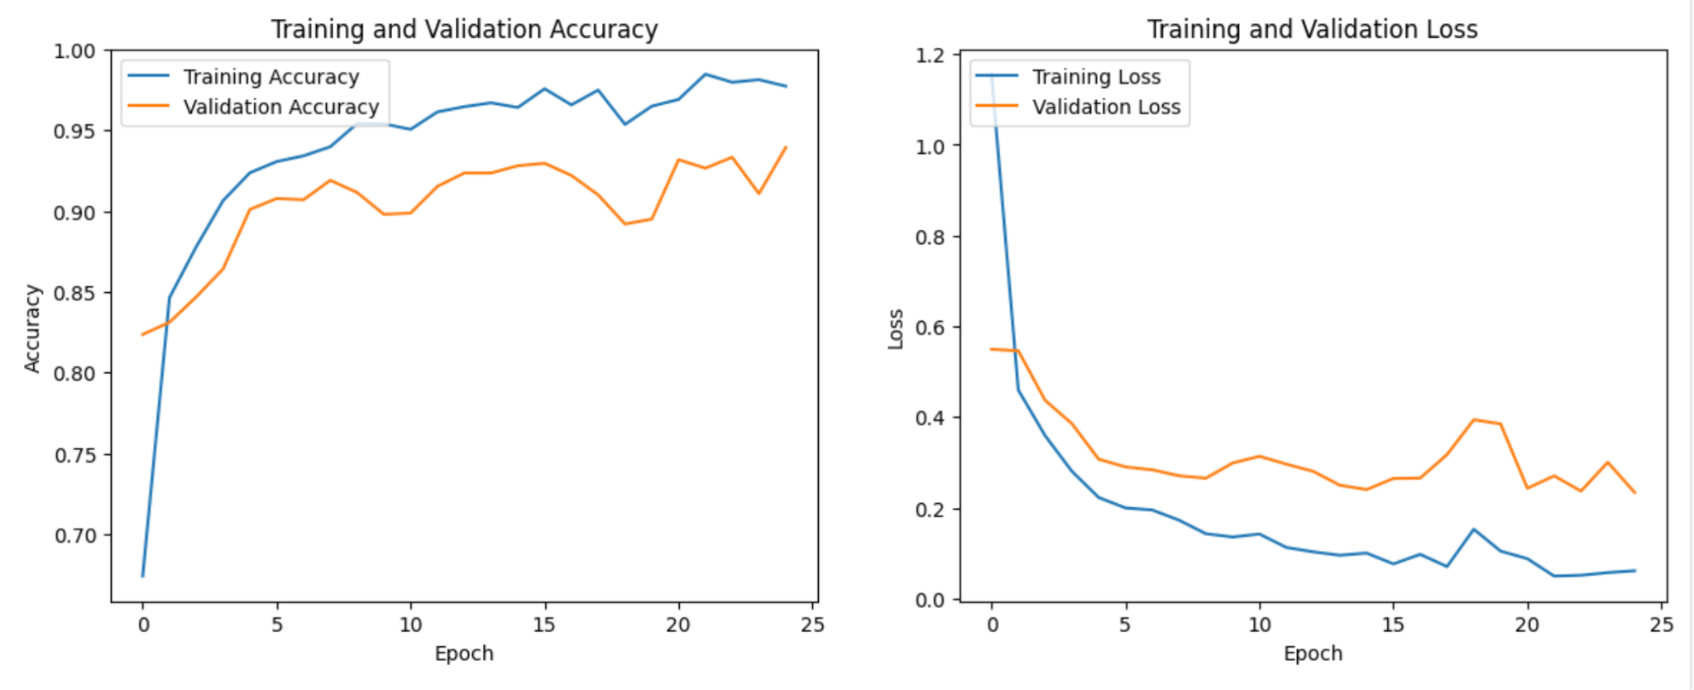
InceptionResNet
Epochs: 25
Optimizer: Adam
Learning Rate: 0.001
Training Time: 30 minutes (on T4 GPU)
Test Acc: 93%

Slide 22
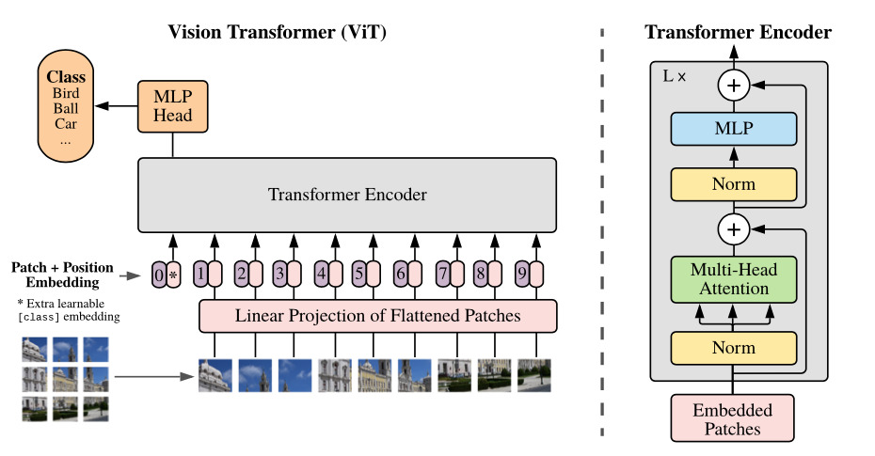
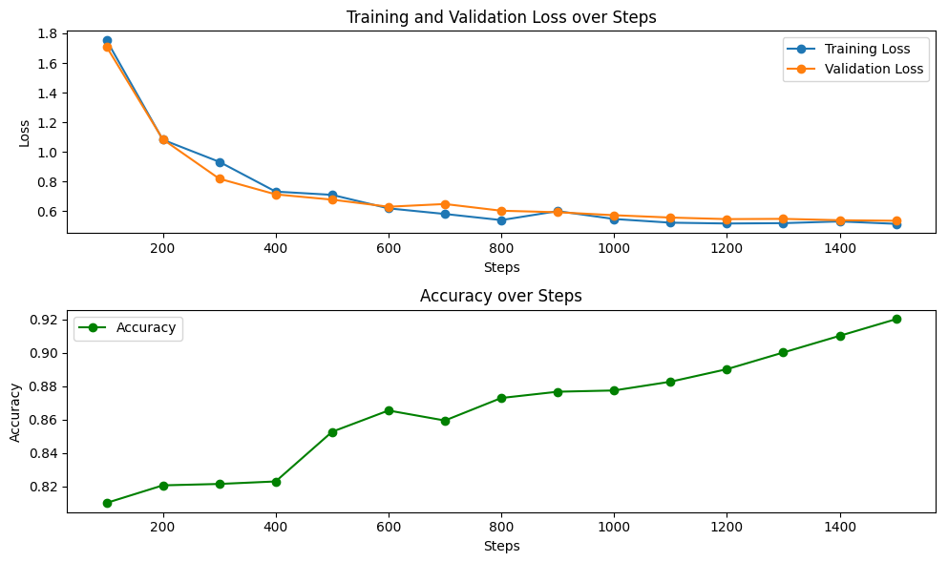
Vision Transformers (ViT)
Steps: 1556
Learning Rate: 0.0002
Training Time: 21 minutes (on T4 GPU)
Train Acc: 96.3%
Test Acc: 92%

Slide 23
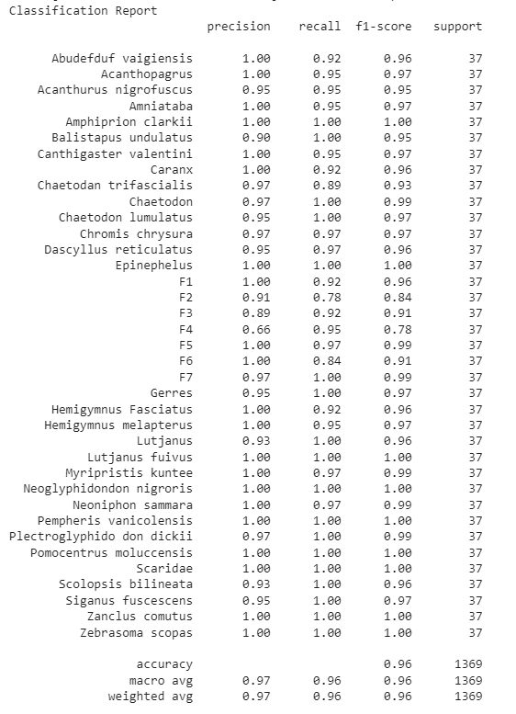
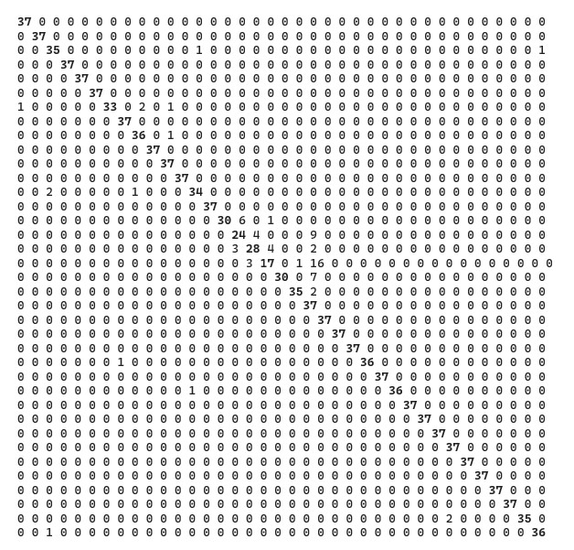
MobileNet – Results
Confusion Matrix

Slide 24
References
Dosovitskiy, A., Beyer, L., Kolesnikov, A., Weissenborn, D., Zhai, X., Unterthiner, T., ... & Houlsby, N. (2020). An image is worth 16x16 words: Transformers for image recognition at scale. arXiv preprint arXiv:2010.11929. https://doi.org/10.48550/arXiv.2010.11929
Fisher, R. B., Shao, K. T., & Chen-Burger, Y. H. (2016). Overview of the fish4knowledge project. Fish4Knowledge: collecting and analyzing massive coral reef fish video data, 1-17. https://doi.org/10.1007/978-3-319-30208-9_1
Iqbal, M. A., Wang, Z., Ali, Z. A., & Riaz, S. (2021). Automatic fish species classification using deep convolutional neural networks. Wireless Personal Communications, 116, 1043-1053. https://doi.org/10.1007/s11277-019-06634-1
O'Shea, K., & Nash, R. (2015). An introduction to convolutional neural networks. arXiv preprint arXiv:1511.08458. https://doi.org/10.48550/arXiv.1511.08458
Prasetyo, E., Suciati, N., & Fatichah, C. (2022). Multi-level residual network VGGNet for fish species classification. Journal of King Saud University-Computer and Information Sciences, 34(8), 5286-5295. https://doi.org/10.1016/j.jksuci.2021.05.015
Rathi, D., Jain, S., & Indu, S. (2017, December). Underwater Fish Species Classification using Convolutional Neural Network and Deep Learning. 2017 Ninth International Conference on Advances in Pattern Recognition (ICAPR), 1-6. https://doi.org/10.1109/icapr.2017.8593044
Saleh, A., Laradji, I. H., Konovalov, D. A., Bradley, M., Vazquez, D., & Sheaves, M. (2020). A realistic fish-habitat dataset to evaluate algorithms for underwater visual analysis. Scientific Reports, 10(1), 14671. https://doi.org/10.1038/s41598-020-71639-x
Salman, A., Jalal, A., Shafait, F., Mian, A., Shortis, M., Seager, J., & Harvey, E. (2016). Fish species classification in unconstrained underwater environments based on deep learning. Limnology and Oceanography: Methods, 14(9), 570-585. https://doi.org/10.1002/lom3.10113
Sandler, M., Howard, A., Zhu, M., Zhmoginov, A., & Chen, L. C. (2018). Mobilenetv2: Inverted residuals and linear bottlenecks. In Proceedings of the IEEE conference on computer vision and pattern recognition (pp. 4510-4520). https://doi.org/10.48550/arXiv.1801.04381
Szegedy, C., Ioffe, S., Vanhoucke, V., & Alemi, A. (2017, February). Inception-v4, inception-resnet and the impact of residual connections on learning. In Proceedings of the AAAI conference on artificial intelligence (Vol. 31, No. 1). https://doi.org/10.48550/arXiv.1602.07261
Tharwat, A., Hemedan, A. A., Hassanien, A. E., & Gabel, T. (2018). A biometric-based model for fish species classification. Fisheries research, 204, 324-336. https://doi.org/10.1016/j.fishres.2018.03.008
Villon, S., Iovan, C., Mangeas, M., Claverie, T., Mouillot, D., Villéger, S., & Vigliola, L. (2021). Automatic underwater fish species classification with limited data using few-shot learning. Ecological Informatics, 63, 101320. https://doi.org/10.1016/j.ecoinf.2021.101320

Slide 25
Thank you! Q&A

